Slide 1

Protecting the CNS
GTHBY
Year 12 General Human Biology

Slide 2
Review: Which part is responsible for…
Problem solving
Balance
Coordination
Breathing
Speech
Smell
7. Vision
8. Taste
9. Memory association
10. Body temperature regulation
11. Decision making
12. Motor control

Slide 3
Learning Intentions
Protection of the central nervous system by bone, meninges and cerebrospinal fluid

Slide 4
Success criteria
Name three ways the central nervous system is protected.
Explain how each works to protect the brain or spinal cord.

Slide 5
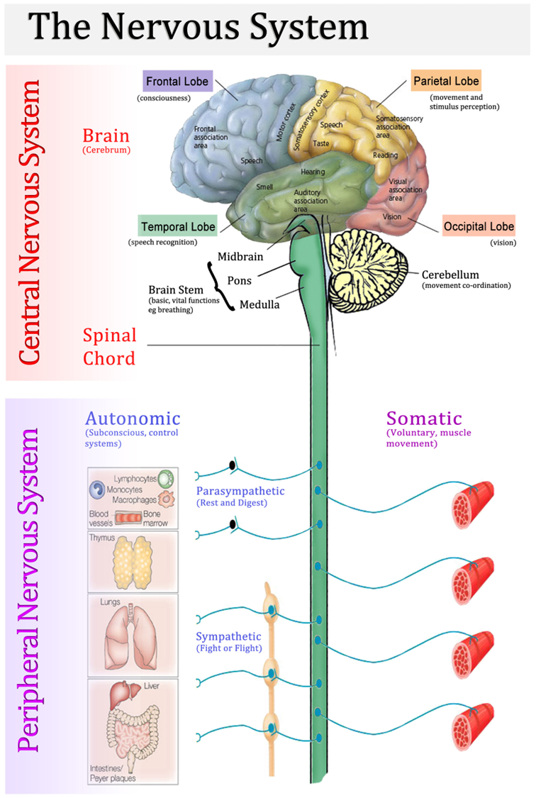
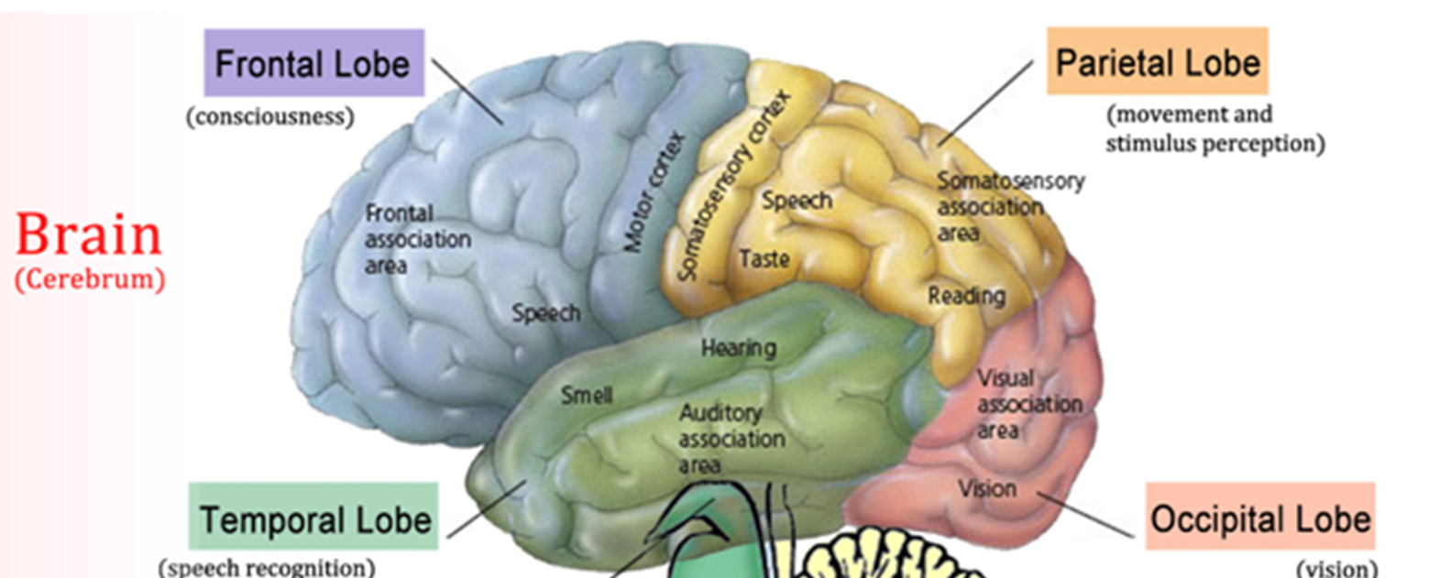

Slide 6
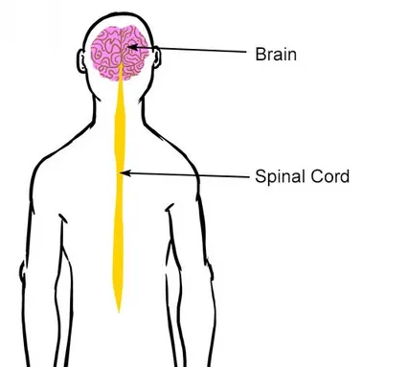
What does the CNS need protection from?

Slide 7
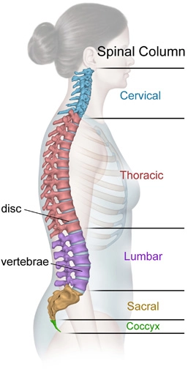
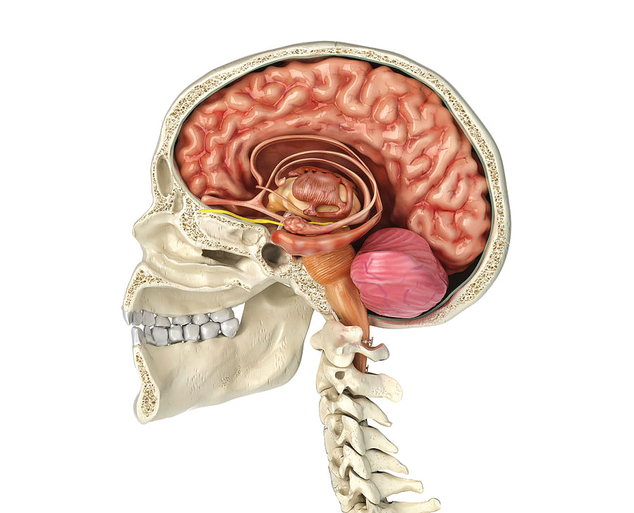
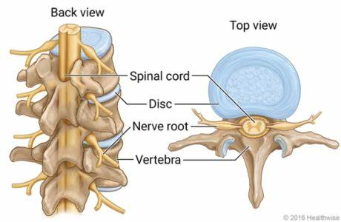
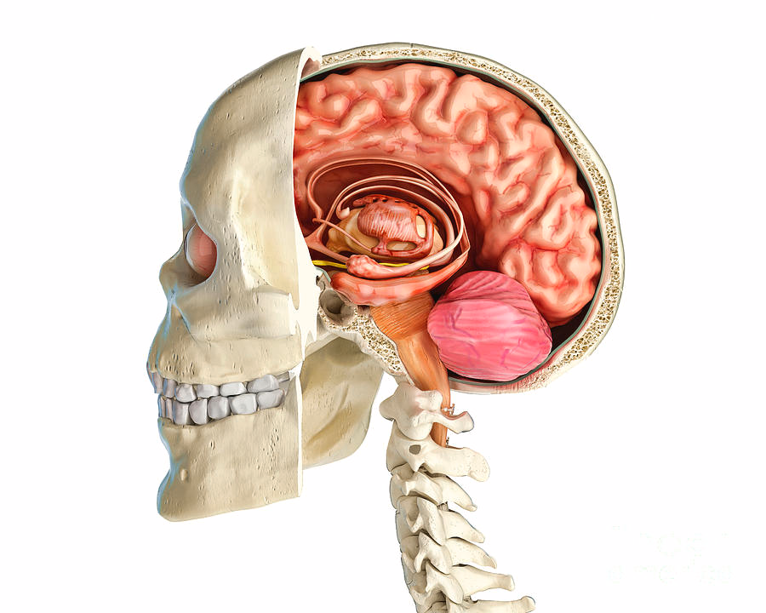
Bone: The skull and spinal cord

Slide 8
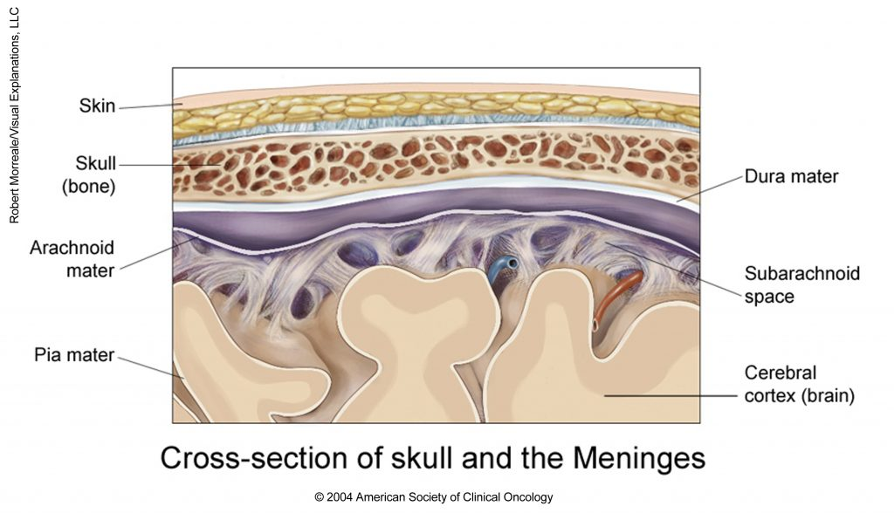
The Meninges: Connective tissue membranes
Dura mater: The outermost membrane, this is the thickest of the three layers and has both an outer and inner layer. It is one of the few structures of the skull capable of feeling pain. The brain itself cannot.
Arachnoid mater: Connected to the dura mater on the side closest to the CNS, this middle layer includes a network of fibers and collagen that are part of the suspension system that helps protect the brain and spinal cord from sudden impact. They also form a gap between the arachnoid and the pia maters called the subarachnoid space. This is where the cerebrospinal fluid is found.
Pia mater: The innermost layer, the pia mater hugs the spinal cord and brain like a coat. It has blood vessels that deliver oxygen and nutrients to the spinal cord.

Slide 9
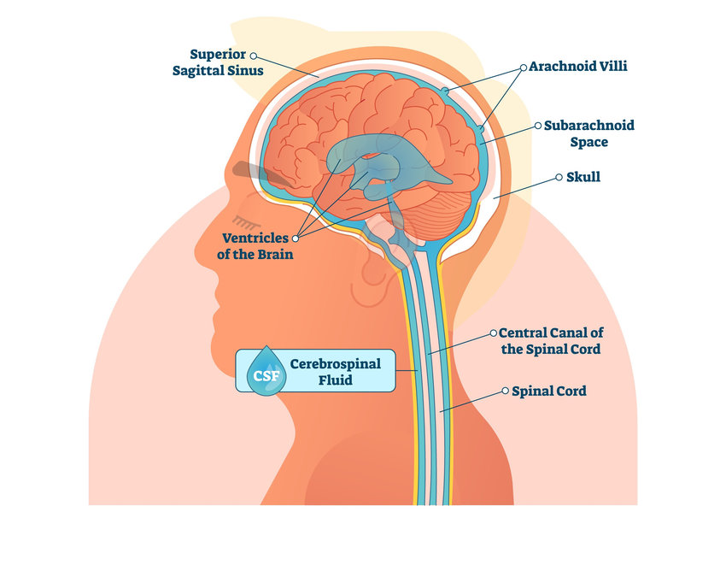
Cerebrospinal fluid
To ensure the brain and the spinal cord do not come into direct contact with any bones of the skull or vertebrae, they float in a clear liquid called cerebrospinal fluid, which acts as a cushion and shock absorber.

Slide 10
Success criteria
Name three ways the central nervous system is protected.
Explain how each works to protect the brain or spinal cord.

